Slide 1


Hii, Iam Siddhika
Welcome to Power BI Series
Part -6

Slide 2

Today Content
Hey Let’s Go
Continuation of
Power Query
CREATING A CALENDAR TABLE INDEX COLUMNS CONDITIONAL COLUMNS GROUPING & AGGREGATING

Slide 3
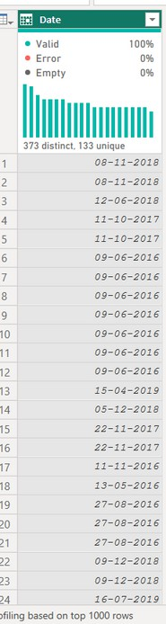
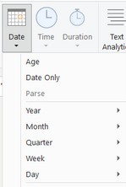

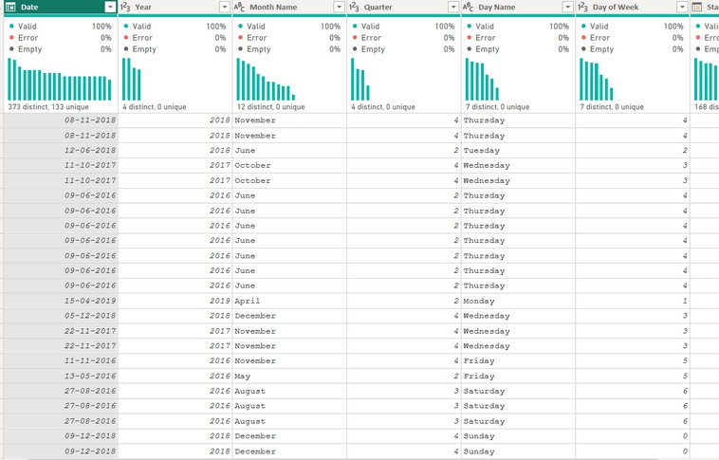

Power Query
CREATING A CALENDAR TABLE
Use the Date options in the Add Column menu to quickly build out an entire calendar table from a list of dates
created calendar table?

Slide 4
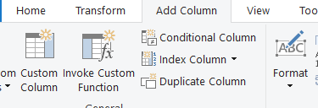

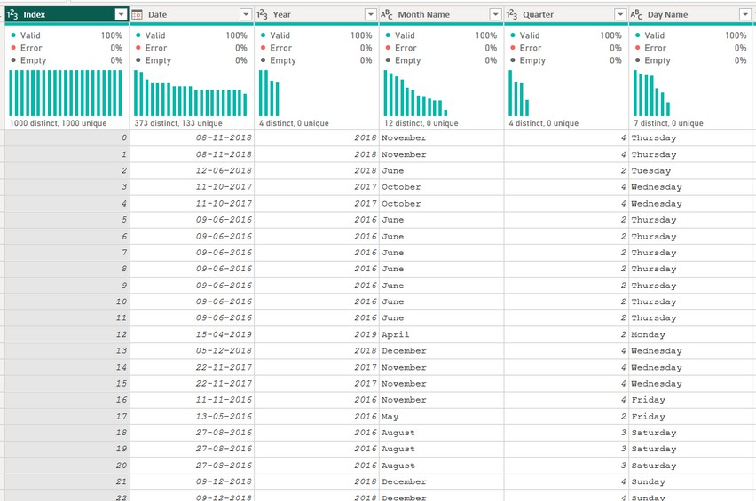
INDEX COLUMNS
Index Columns contain a list of sequential
values that can be used to identify each unique row in a table (typically starting from 0 or 1)
check this

Slide 5
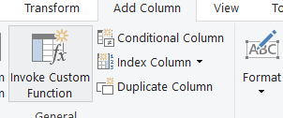
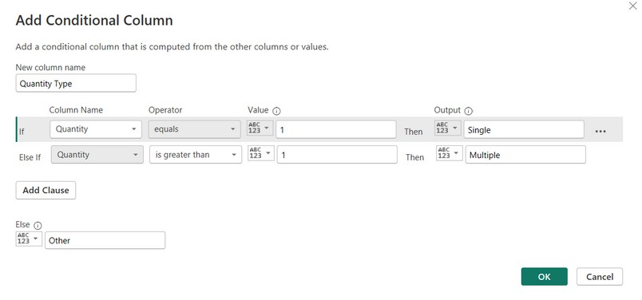

CONDITIONAL COLUMNS
Conditional Columns allow you to define new fields based
on logical rules and conditions (IF/THEN statements)
What conditions you have given?
Here we’re creating a conditional column named Quantity Type, which is based on Order Quantity:
If Order Quantity =1, Quantity Type = “Single Item”
Else If Order Quantity >1, Quantity Type = “Multiple Items”
Else; Quantity Type = “Other”

Slide 6
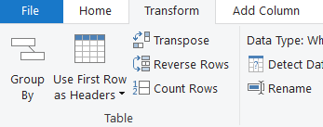
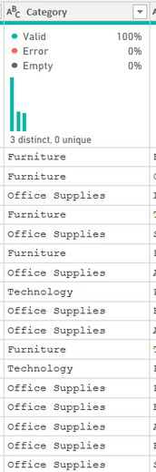
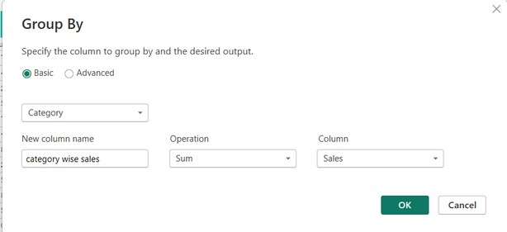
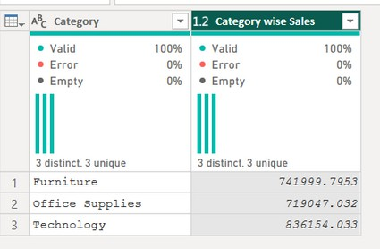
GROUPING & AGGREGATING
Group By allows you to aggregate data at a different level . (i.e. group daily records into
monthly, aggregate transactions by store, etc.)
Have you
grouped any?
Here we’re calculating category wise sales

Slide 7

Thank you for joining me today to learn about Part -6 of Power BI!
Remember, with features like creating calendar tables, index columns, conditional columns, and grouping & aggregating, you can take your data analysis to the next level.
Stay tuned for more insights and tips on Power BI in our next Series.
Follow
Siddhika Shah

